Slide 1
Mini – Project
“Investar”
1조

Slide 2

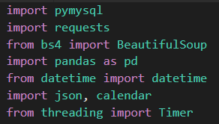

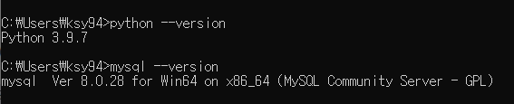

Slide 3
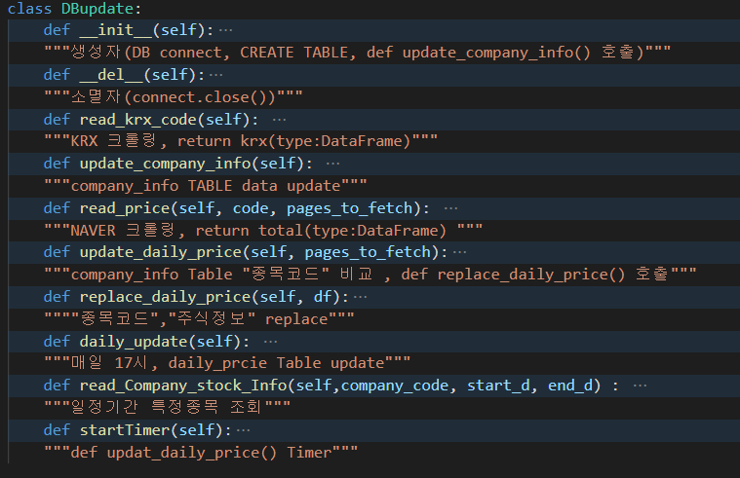
def

Slide 4
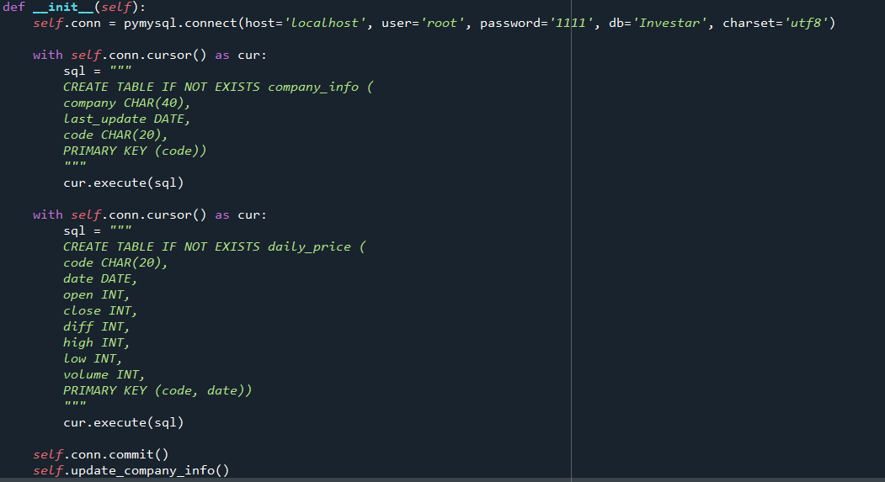
def __init__(self):

Slide 5

def __del__(self):

Slide 6
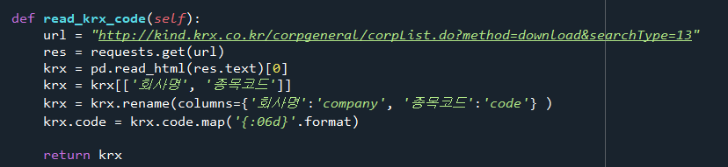
def read_krx_code(self):

Slide 7
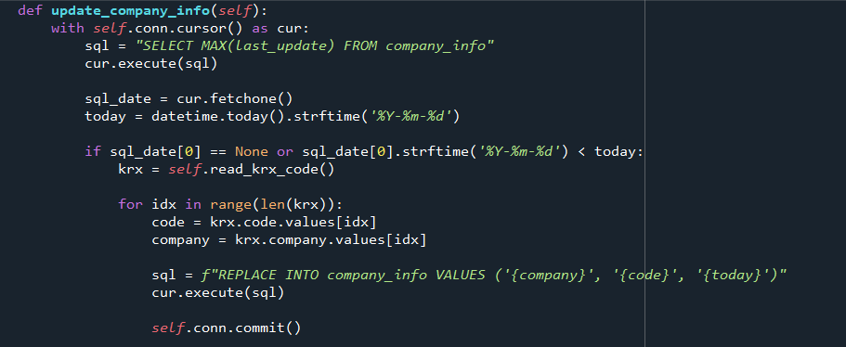
def update_comp_info(self)

Slide 8
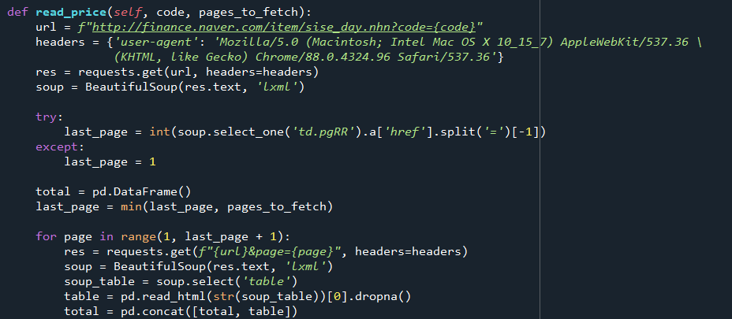
def read_naver(self, code, pages_to_fetch):

Slide 9
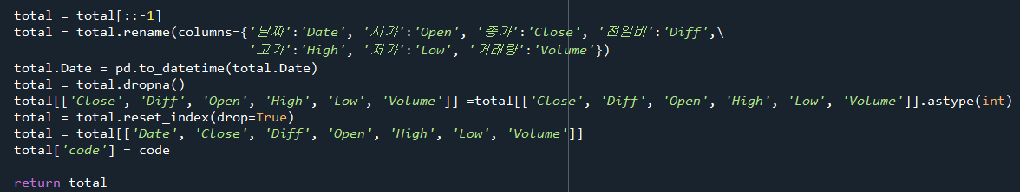
def read_naver(self, code, pages_to_fetch):

Slide 10
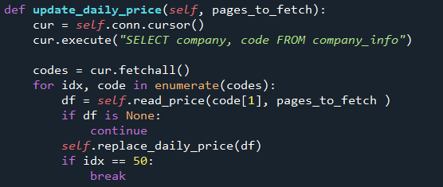
def update_daily_price(self, pages_to_fetch):

Slide 11
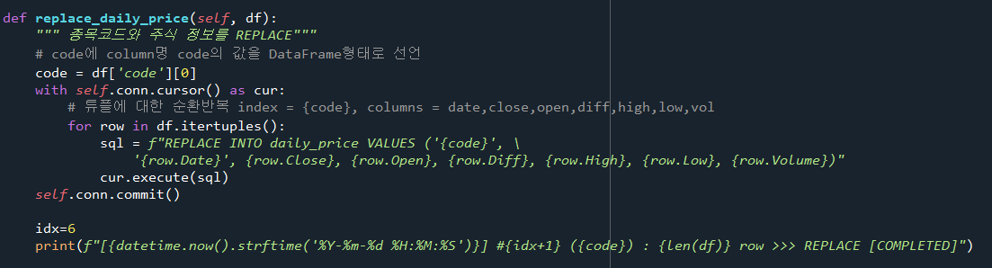
def replace_daily_price(self, df):

Slide 12
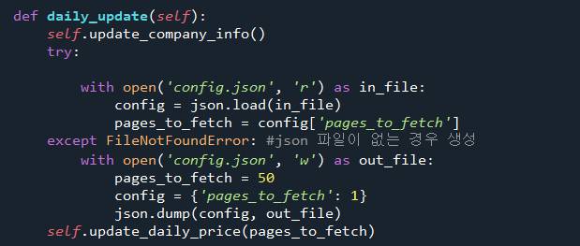
def daily_update(self):

Slide 13
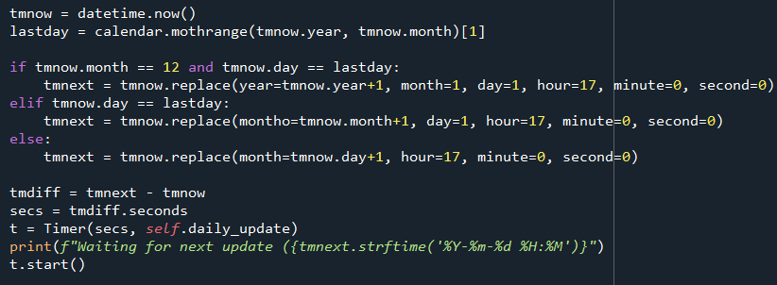
def daily_update(self):

Slide 14
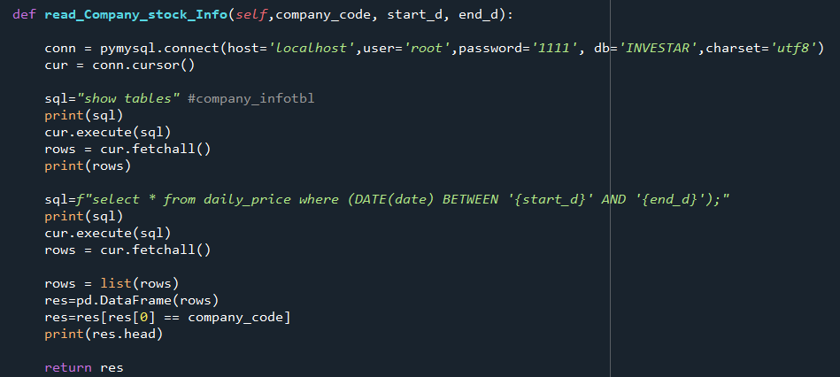
def read_Company_stock_Info(self,company_code, start_d, end_d):

Slide 15
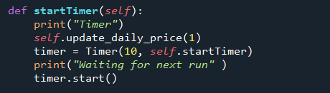
def startTimer(self):

Slide 16
사용

